Slide 1
Welcome to our project…..

Slide 2

A COMPREHENSIVE ANALYSIS OF FINANCIAL PERFORMANCE: INSIGHTS FROM A LEADING BANKS

Slide 3
TEAM LEADER: V.CHANDRU TEAM MEMBER: V.VELMURUGAN
TEAM MEMBER:K.PAVITHRA.
We, a team of 3 students are from III- B.Sc.., Mathematics,
Solai College of arts and science,Usilampatty,Madurai.

Slide 4
1.INTRODUCTION:
The banking industry world-wide is being transformed . The global forces for change include technological innovation ; the deregulation of financial services at the national level and opening up to international competition ; and- equally important- changes in corporate behaviour, such as growing disintermediation and increased emphasis on shareholder value.
Recent banking crisis in Asia and Latin America have accentuated these pressures. The banking industries in central Europe and Latin America have also been transformed as a result of privatizations of state-owned banks that had dominated their banking systems in the past.
In this project, we are analysis the bank related data and able to extract some Insights from the data using.

Slide 5
1.2.PURPOSE:
In this project we are trying to analysis the bank related data and able to extract some insights from the data using Business Intelligence tools.

Slide 6
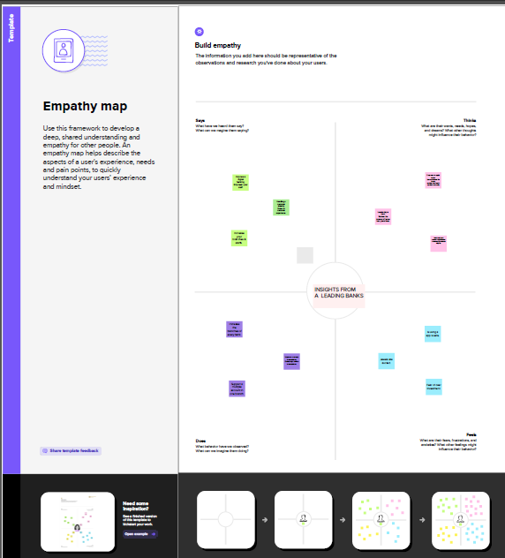
2.PROBLEM DEFINITION&DESIGN THINKING: 2.1EMPATHY MAP:

Slide 7
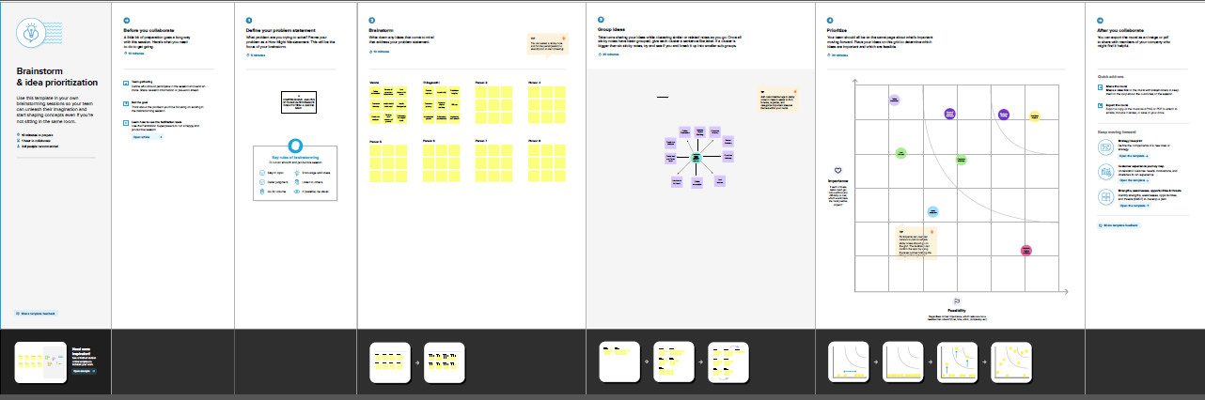
2.2.IDEATION & BRAINSTORM MAPPING:

Slide 8
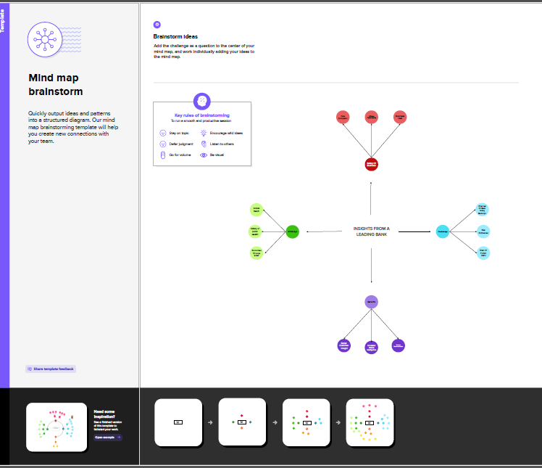
2.2.BRAINSTORM MAPPING:

Slide 9
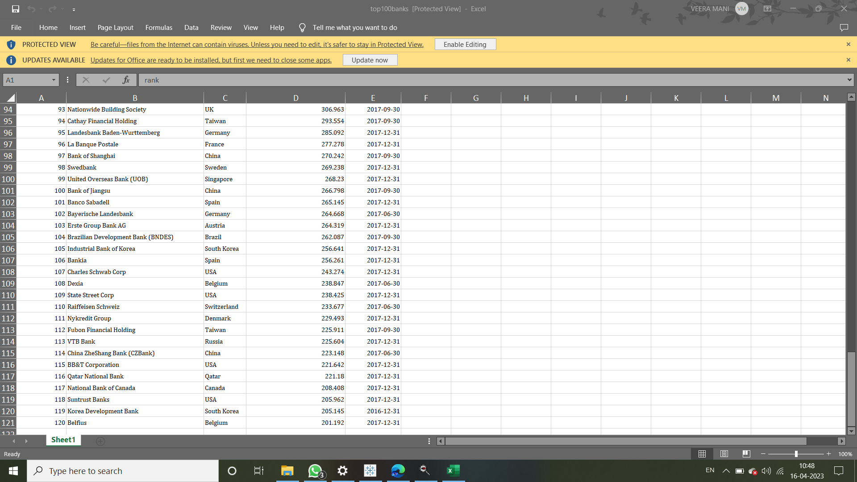

Slide 10
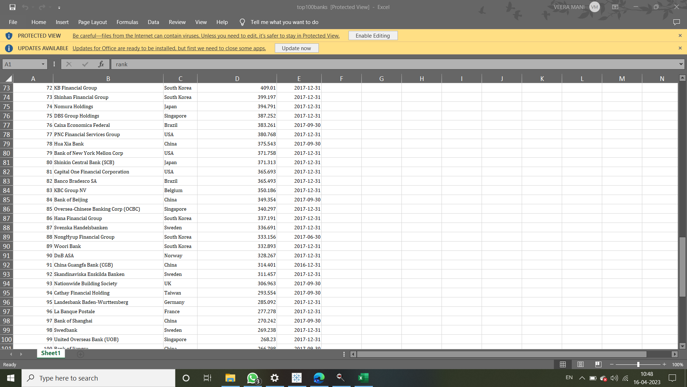

Slide 11
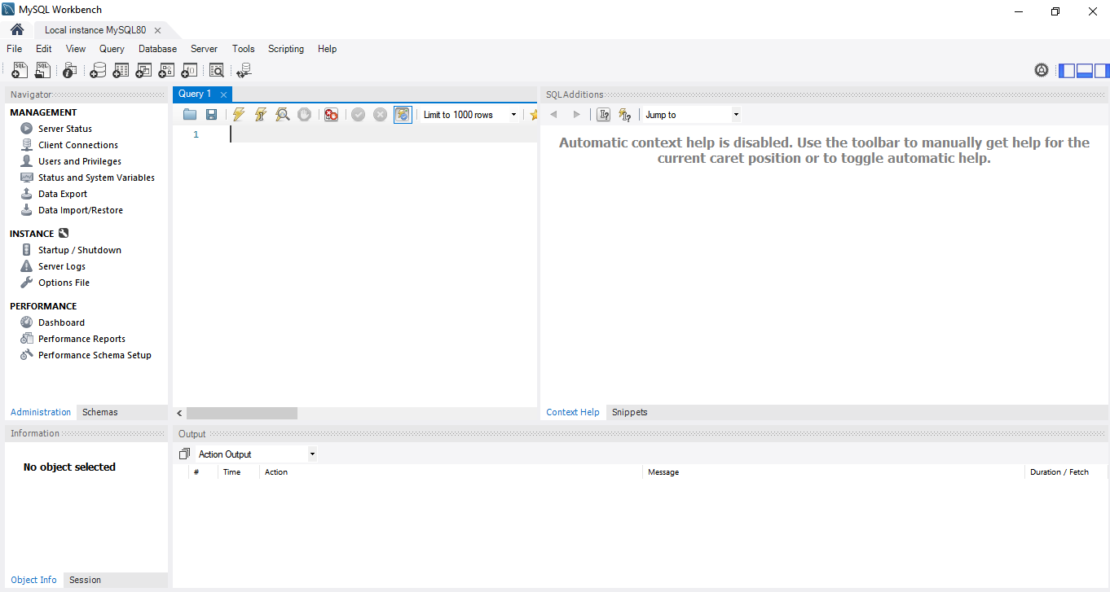
3.RESULT:

Slide 12
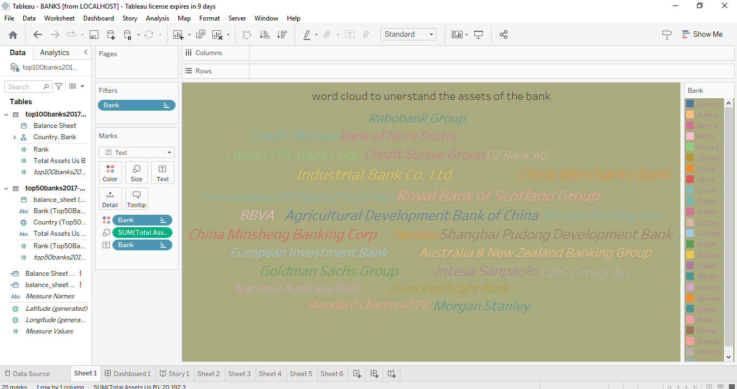

Slide 13
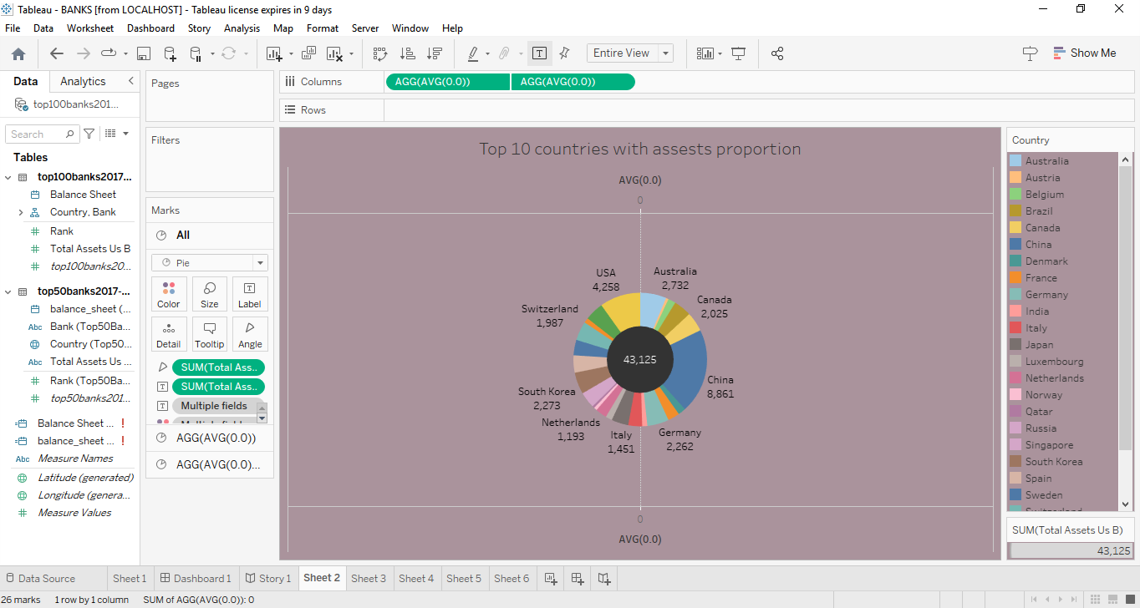

Slide 14
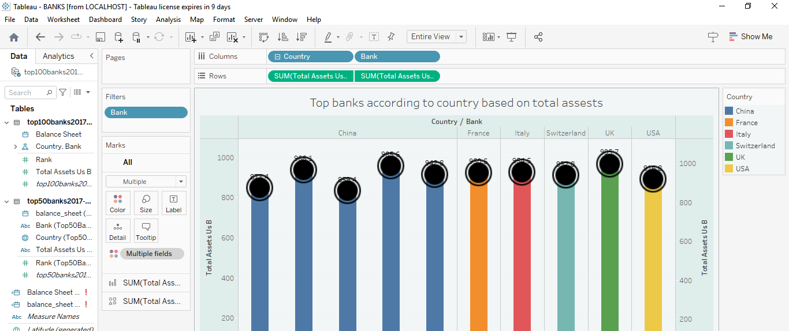

Slide 15
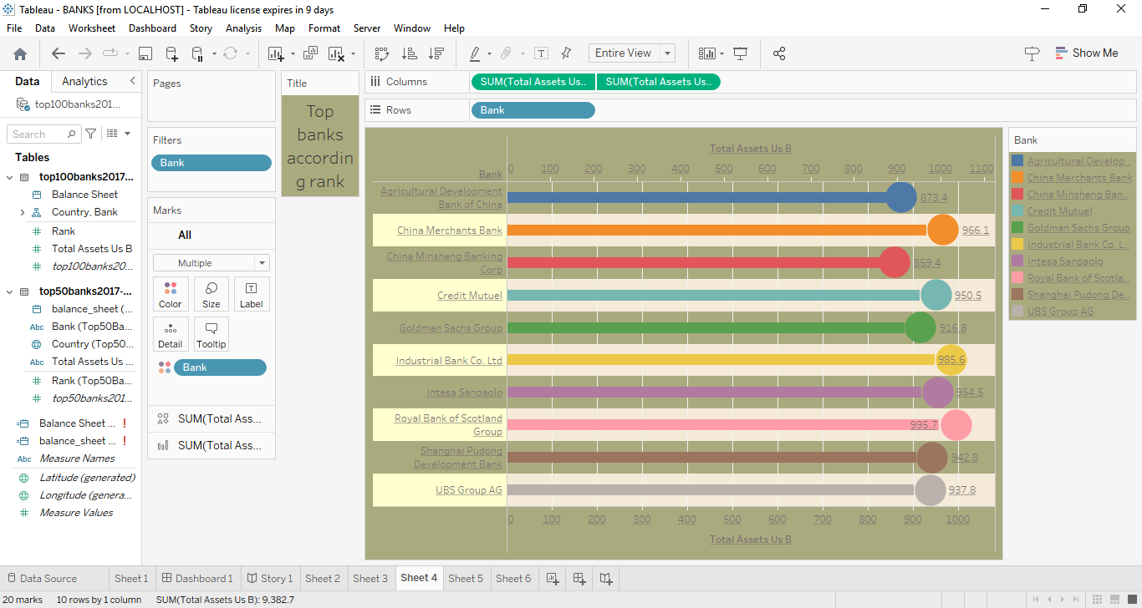

Slide 16
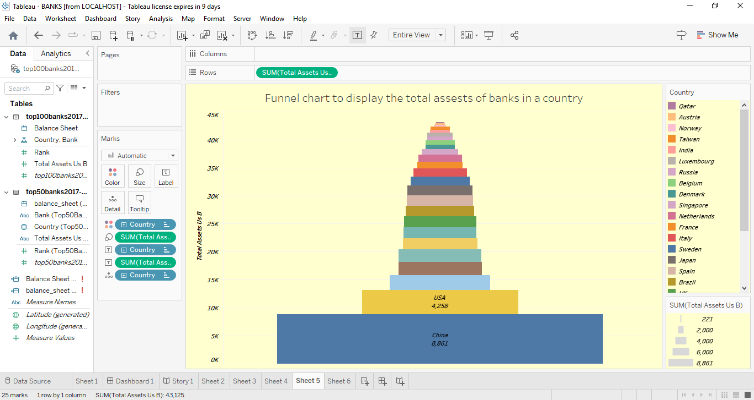

Slide 17
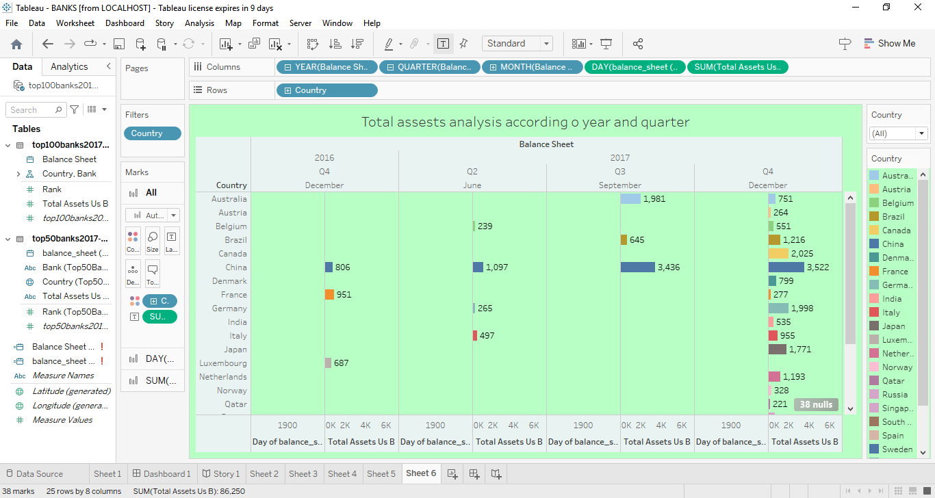

Slide 18
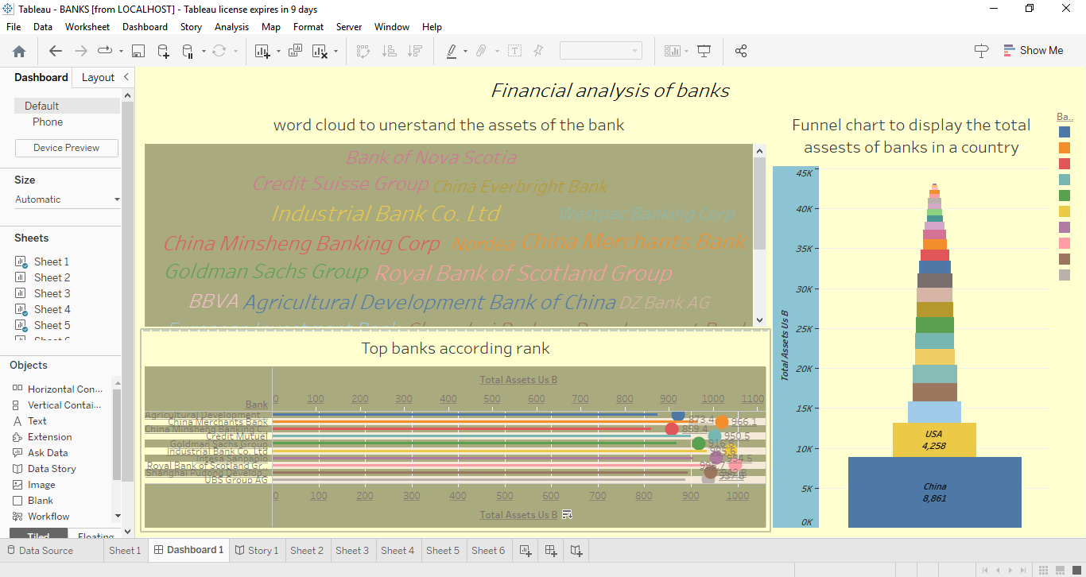
DASHBOARD:

Slide 19
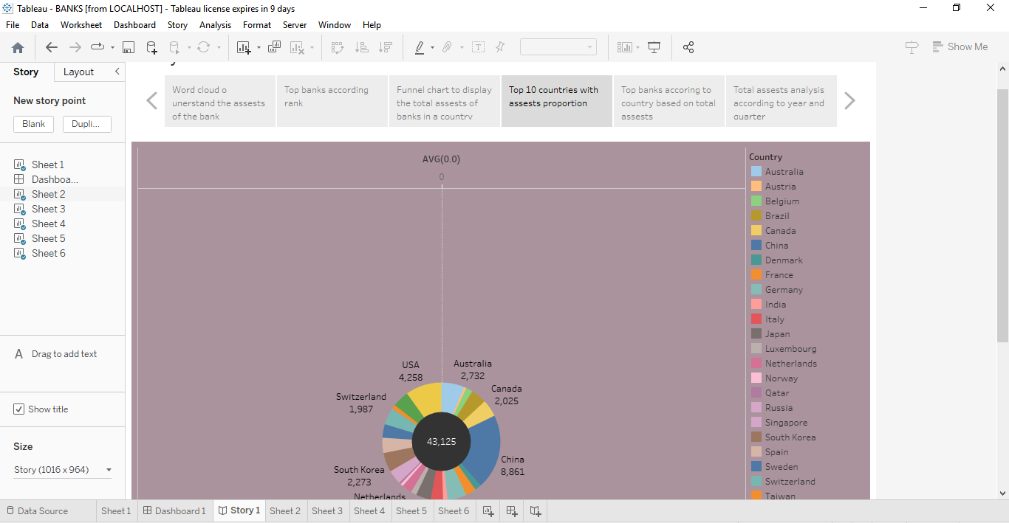
STORY BOARD:

Slide 20


Slide 21
4.ADVANTAGES AND DISADVANTAGES:
ADVANTAGES:
Safety of public wealth
Availability of cheap loans
Propellant of economy
Development in rural areas
Global reach
DISADVANTAGES:
Chances of bank ging bankrupt.
Risk of fraud and robberies.
Risk of public debt.
At one time analysis.
Interest rate risk

Slide 22
5.APPLICATION:
RISK MANAGEMENT :
Financial performance metrics can help banks identity potential risks and vulnerabilities in their operations ,allowing them to take steps to mitigate them
INVESTMENT DECISIONS :
Financial performance metrics can hep investors make informed decisions about buying , holding , or selling shares of a bank’s stock.
STRATEGIC DECISION MAKING :
Banks can use financial performance analysis to assess there competitive position and make strategic decisions to improve profitability and market share.

Slide 23
6.CONCLUSION:
Here we analyse the financial performance of banks by Empathy map, Brainstorming, Data preparation, Data visualization, Dashboard, Story , Web integration.

Slide 24
7.FUTURE SCOPE:
Increased operational efficiency, profitability and productivity.
Superior customer service.
Improved management and accountability.
Minimal transaction costs.
Improved financial analysis capabilities.
Use of big data and artificial intelligence
Integration of environmental , social and governance factors.

Slide 25
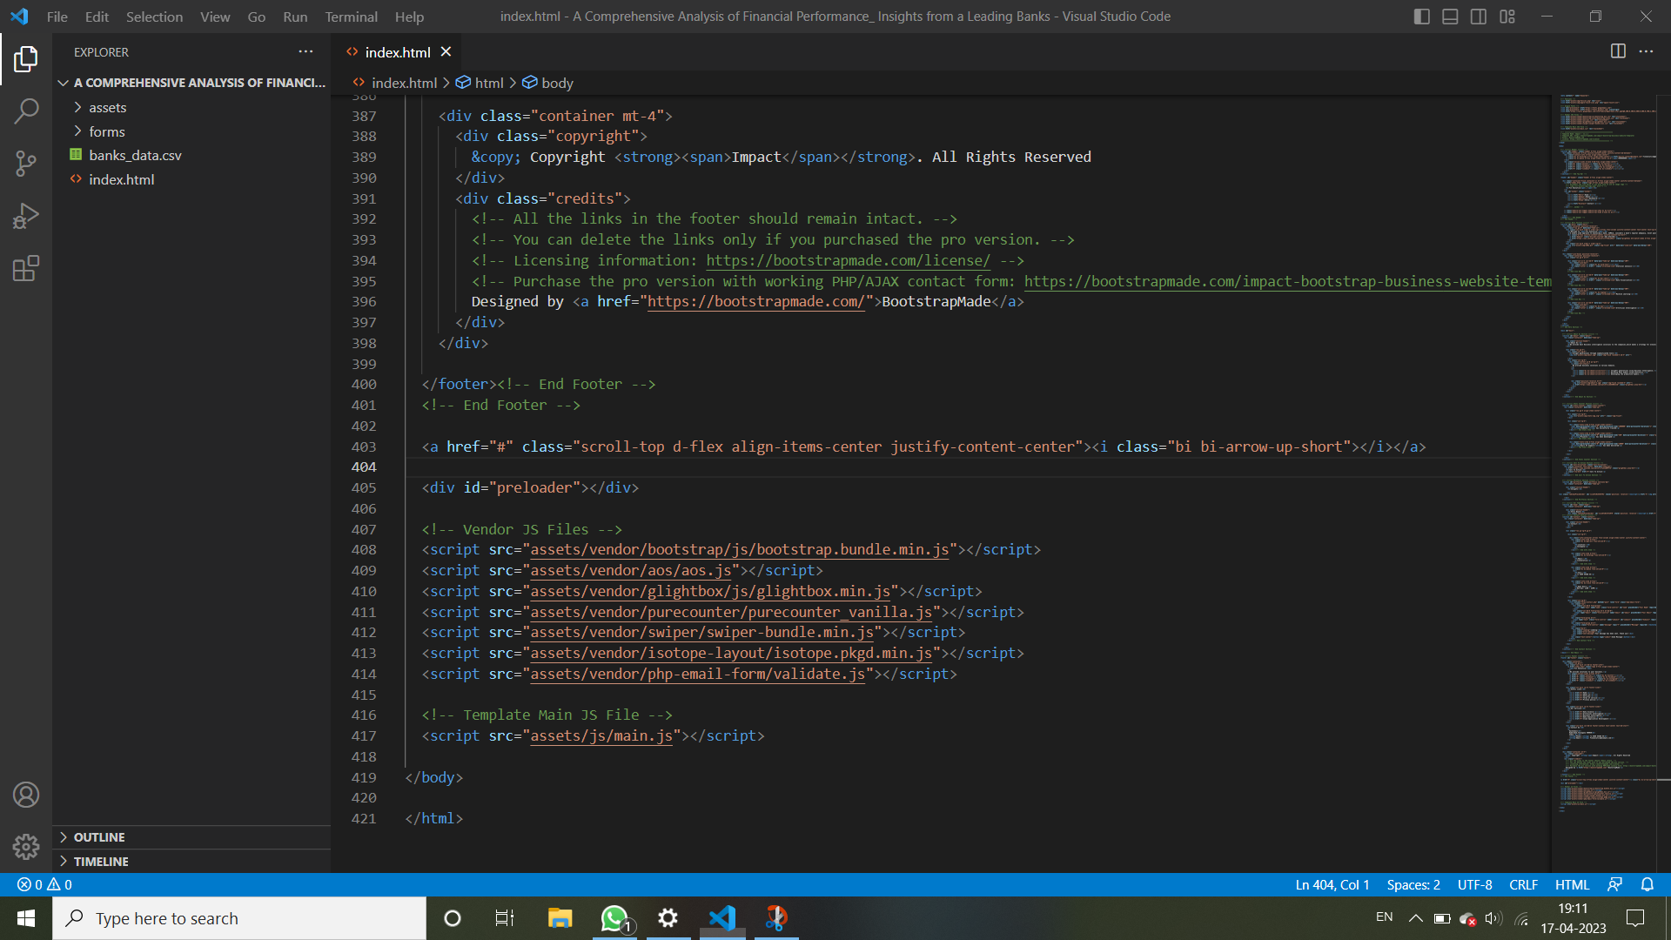
8.APPENDIX:

Slide 26


